Slide 1


Movie Quotes About
Statistics
A Cinematographic Investigation
By Nick Evangelopoulos
Most photos provided via IMDb. Some material may be copyrighted.

Slide 2




Pop Quiz!
How much have you learned about statistics by just watching movies?
1940s
1950s
1960s
21st century

Slide 3

Statistics and the big facts of life
Statistics show that there are more women in the world than anything else.
Except insects.
Glenn Ford in Gilda (1946)
© Columbia 1946

Slide 4
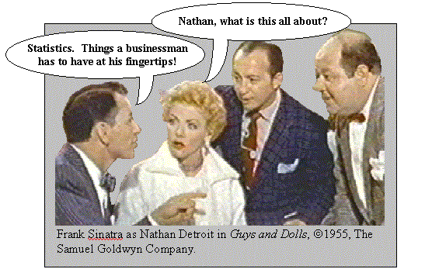
Should business people study statistics?
© Samuel Goldwyn/MGM 1955
Frank Sinatra in Guys and Dolls (1955)

Slide 5

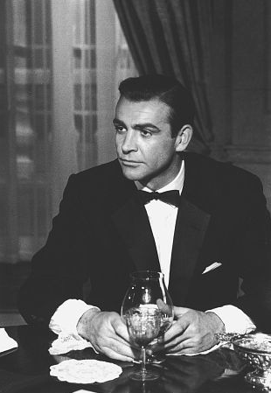
Statistics in National Security
Yes, well, I've worked out a few statistics of my own. 15 billion dollars in gold bullion weighs 10,500 tons. Sixty men would take twelve days to load it onto 200 trucks.
Now, at the most, you're going to have two hours before the Army, Navy, Air Force, and Marines move in and make you put it back!…
Sean Connery in Goldfinger (1964)
© United Artists 1964

Slide 6

How best decisions are made
We have no way of knowing what lies ahead for us in the future… All we can do is use the information at hand to make the best decision possible!
Christopher Walken in Wedding Crashers (2005)
© WireImage 2003

